Slide 1
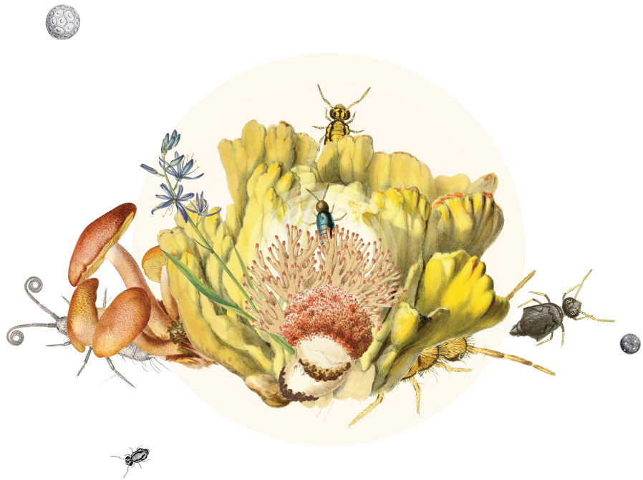
Soil
Notes:
Text from postcard: By working with expert communities to integrate soilbiodiversity data with data from other environments, GBIF helps reveal the extraordinary biological diversity below ground and our understanding of the complex sources of life on Earth.

Slide 2
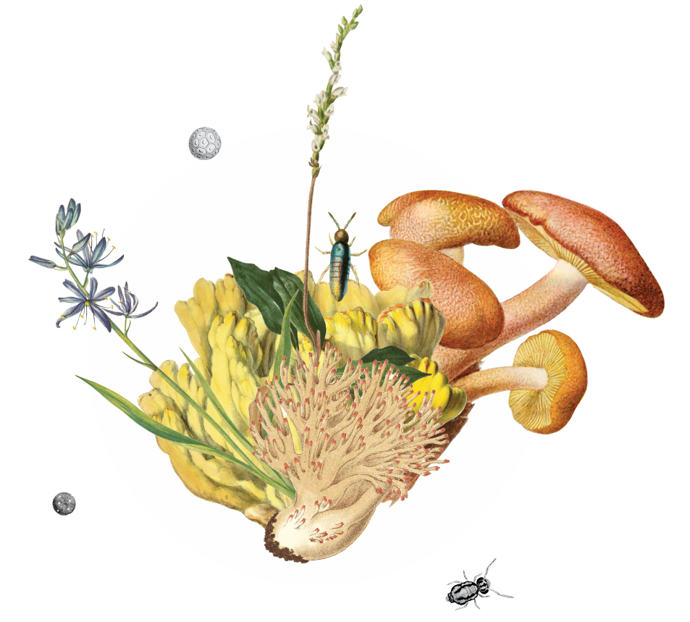
Soil
Revealing the extraordinary biological diversity below ground GBIF mediated-data is vital for enriching research and knowledge of life on earth
Notes:
Notes

Slide 3
Soil
Even tiny amounts of soil can contain thousands of species and millions of individual organisms that form dynamic ecosystems harbouring an extraordinary diversity of life. This intricate web of life plays a critical role in maintaining the planet's health, climate and productivity: soil hosts a quarter of all life on the planet and directly or indirectly supports 95 per cent of the food we eat.
Data on soil biodiversity thus provides unique evidence for forming insights into broader ecological patterns, interactions and processes. By working with expert communities like SoilBON and the Global Soil Biodiversity Initiative to integrate soil biodiversity data with data from other environments, GBIF helps reveal a more comprehensive understanding of the complex sources of life—on and in—Earth.

Slide 4

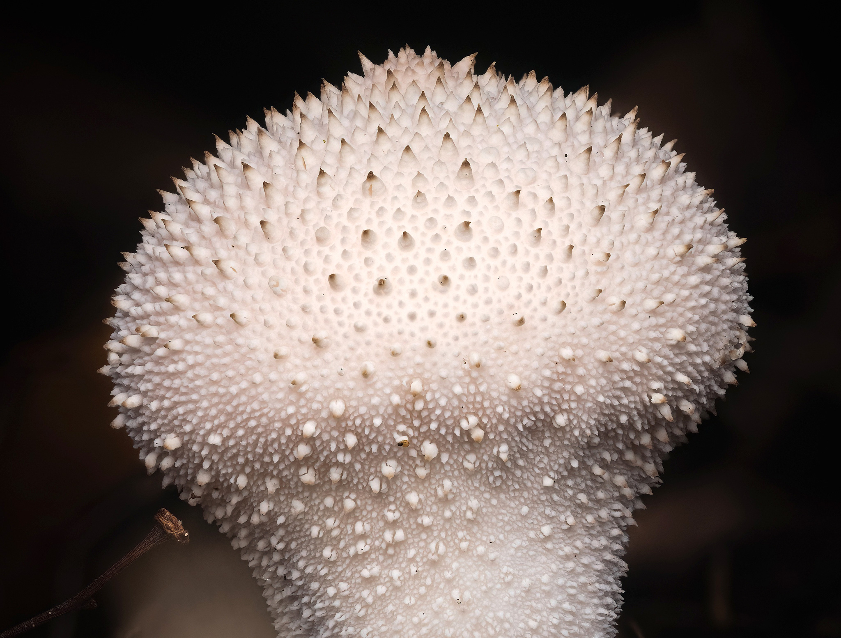
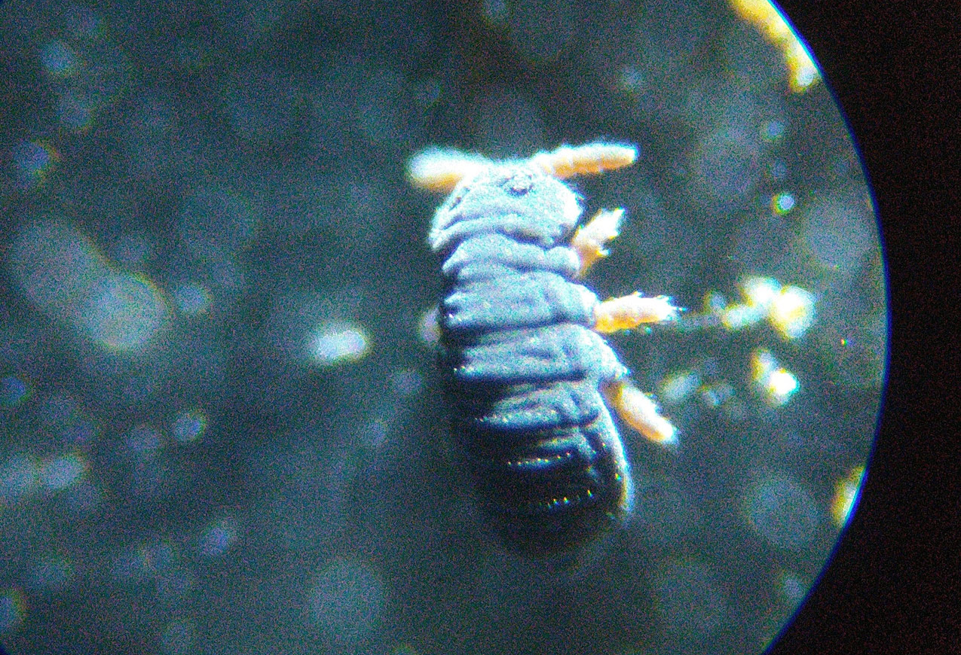
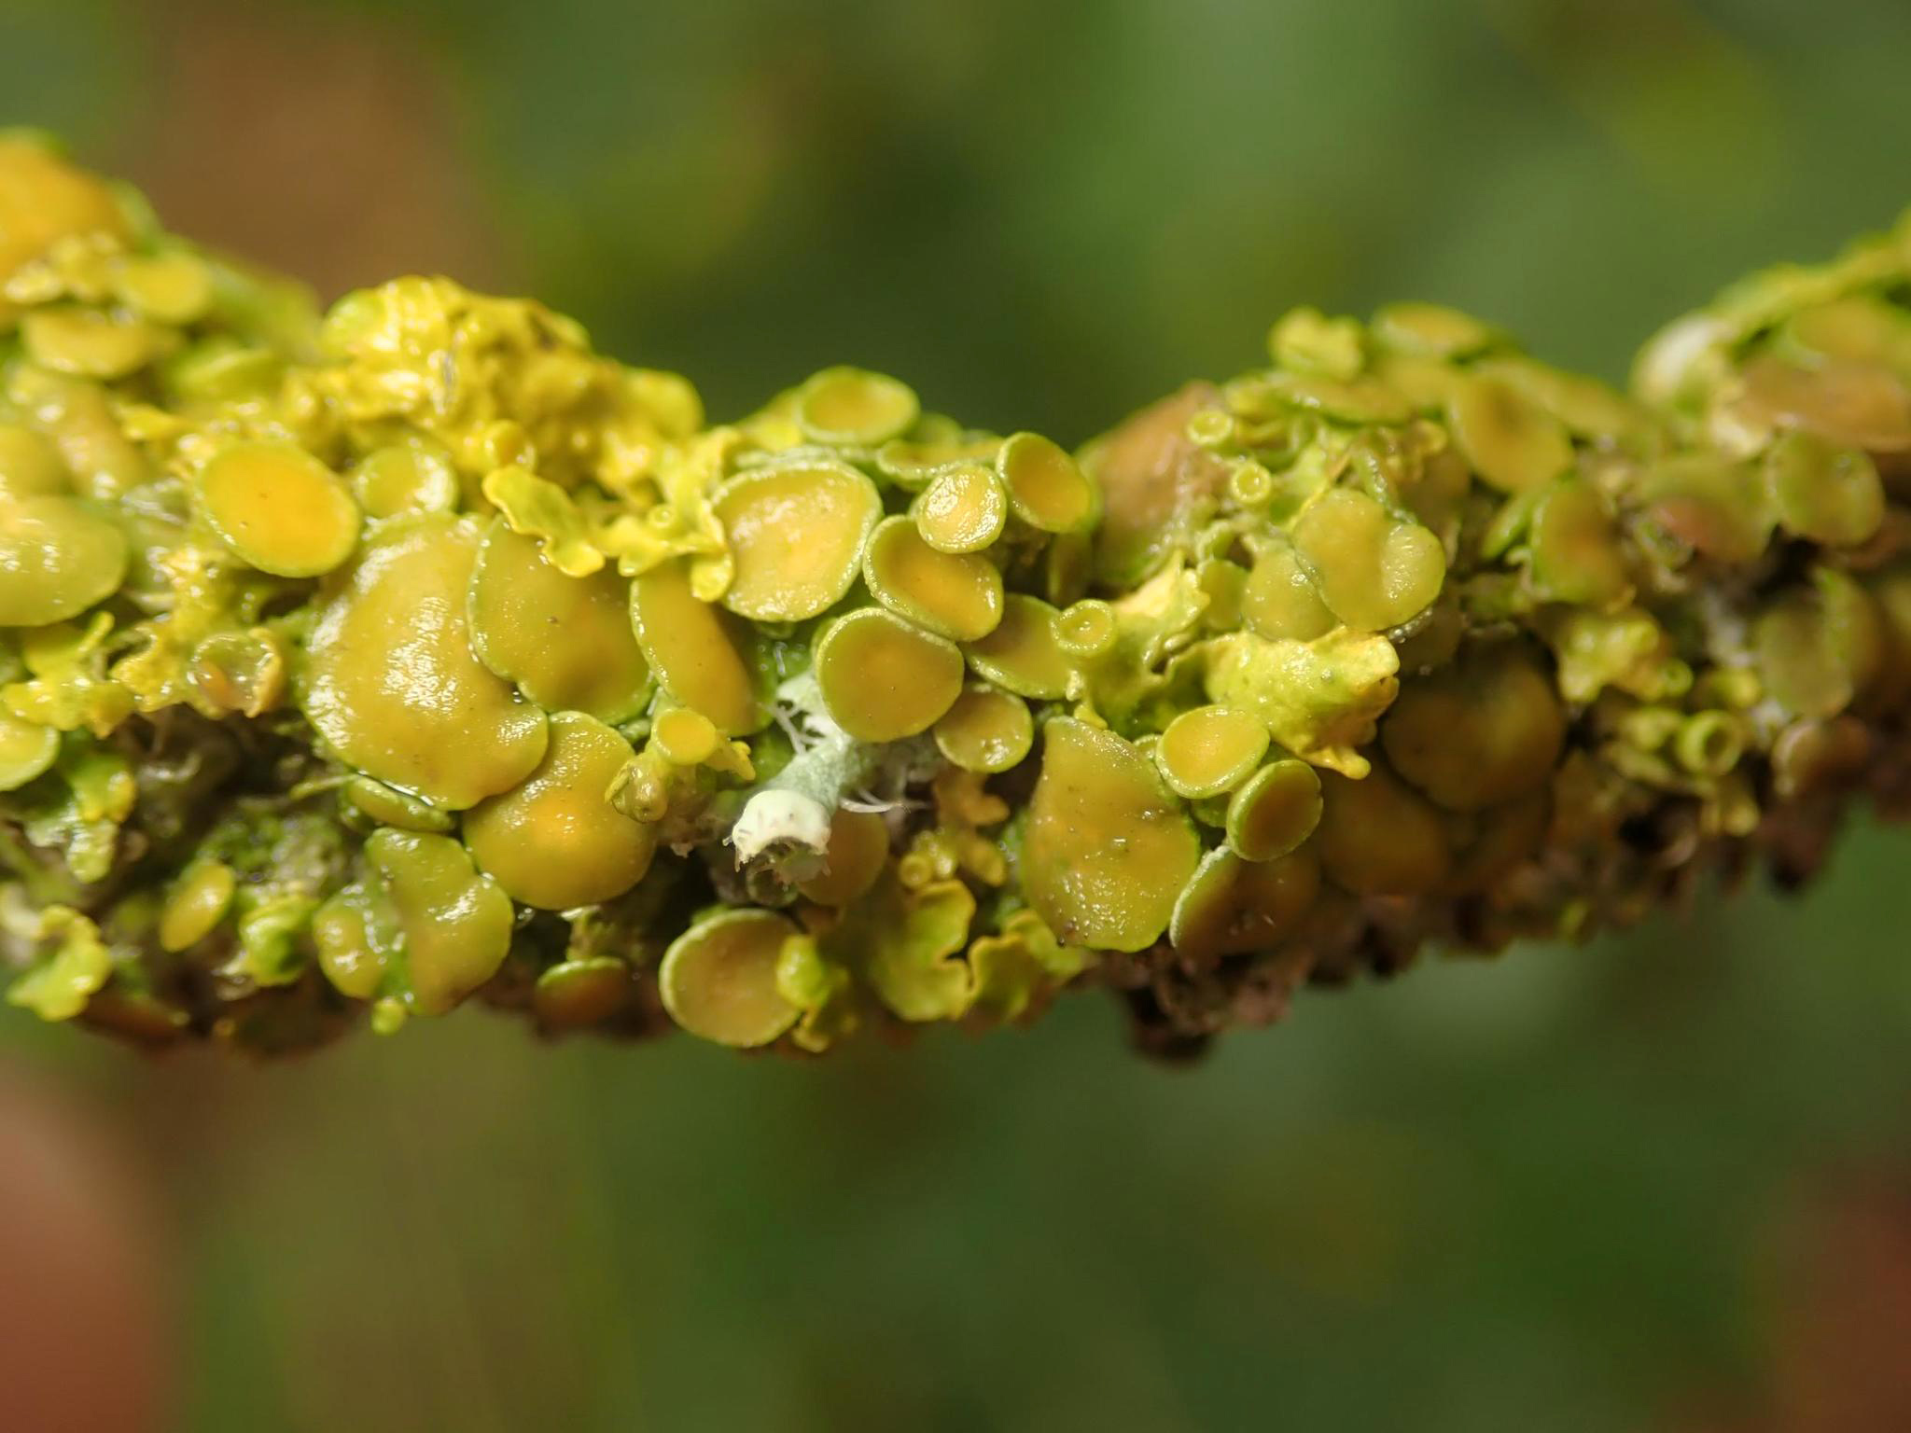
Featured publishers of soil-related data
MGnify
Institute of Physicochemical and Biological Problems in Soil Science, Russian Academy of Sciences
Moscow Pedagogical State University (MPSU)
Biodiversity Exploratories
Notes:
Notes

Slide 5
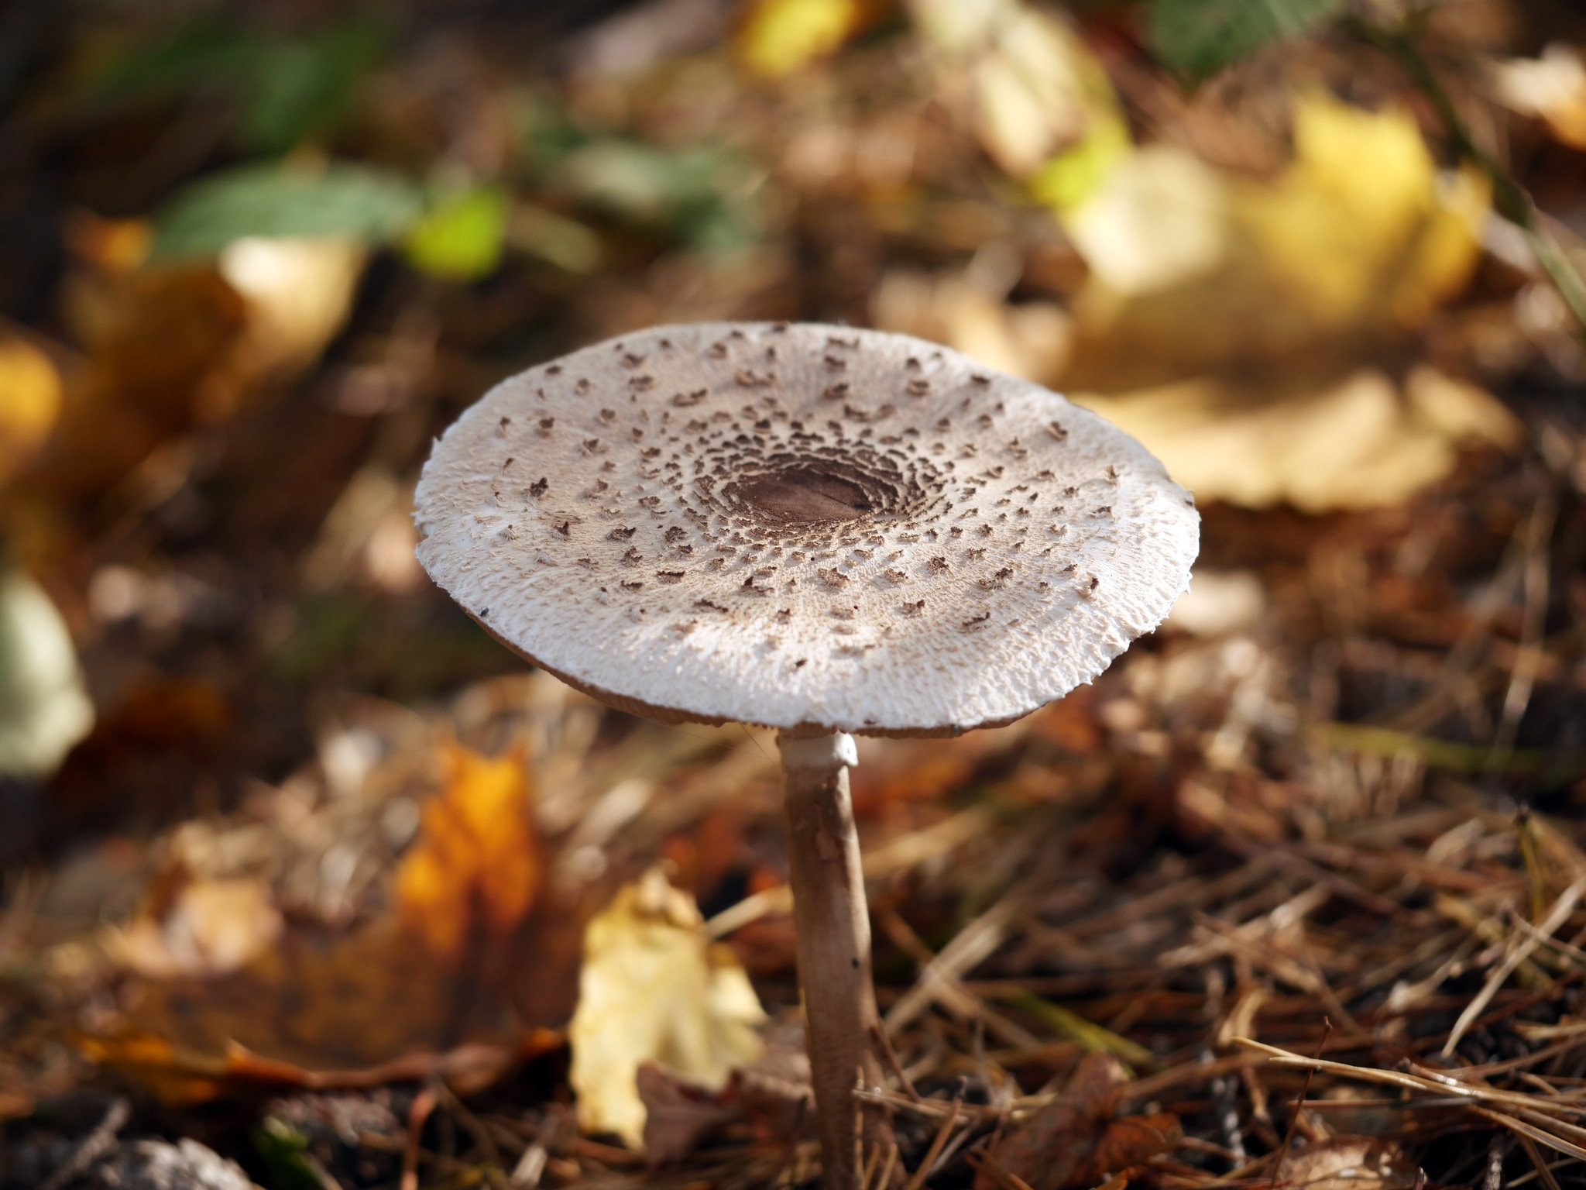
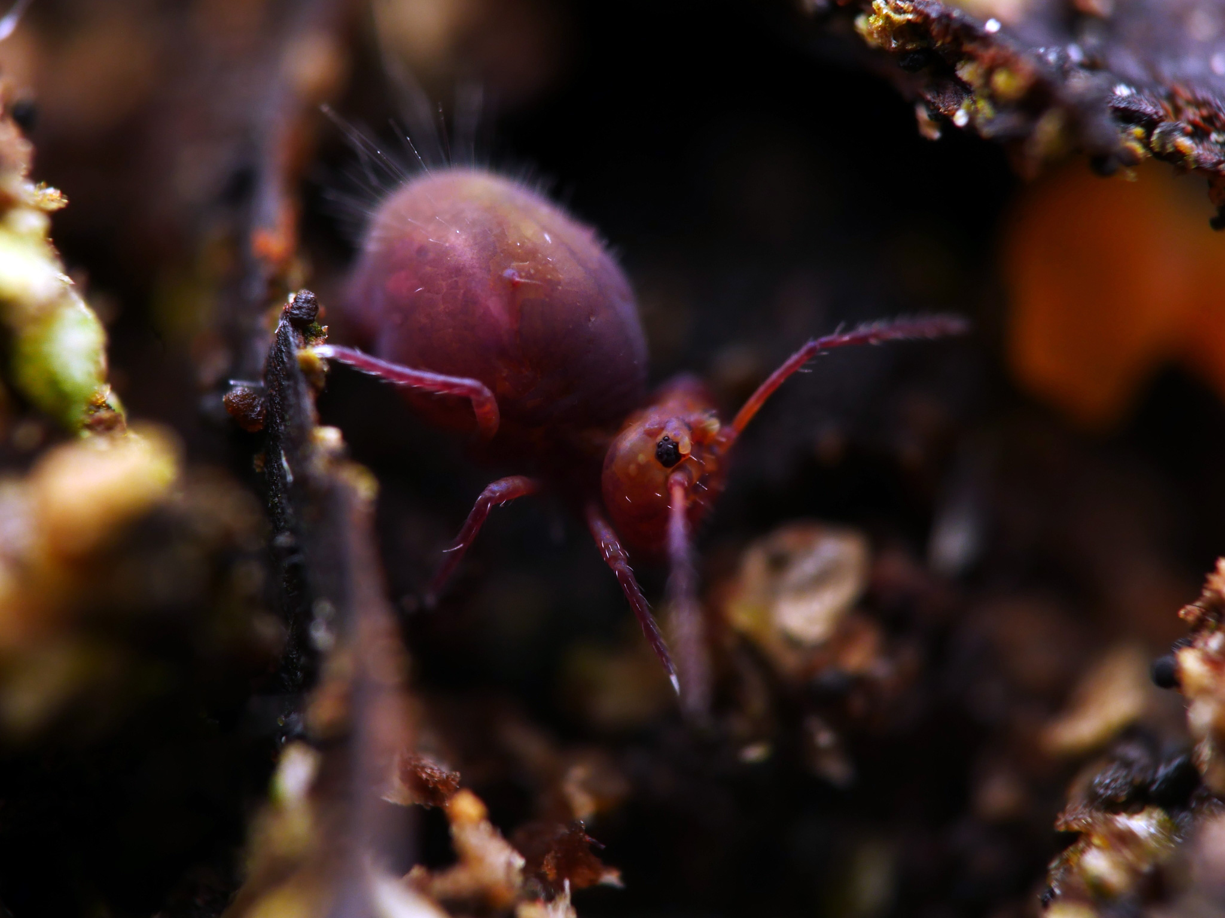
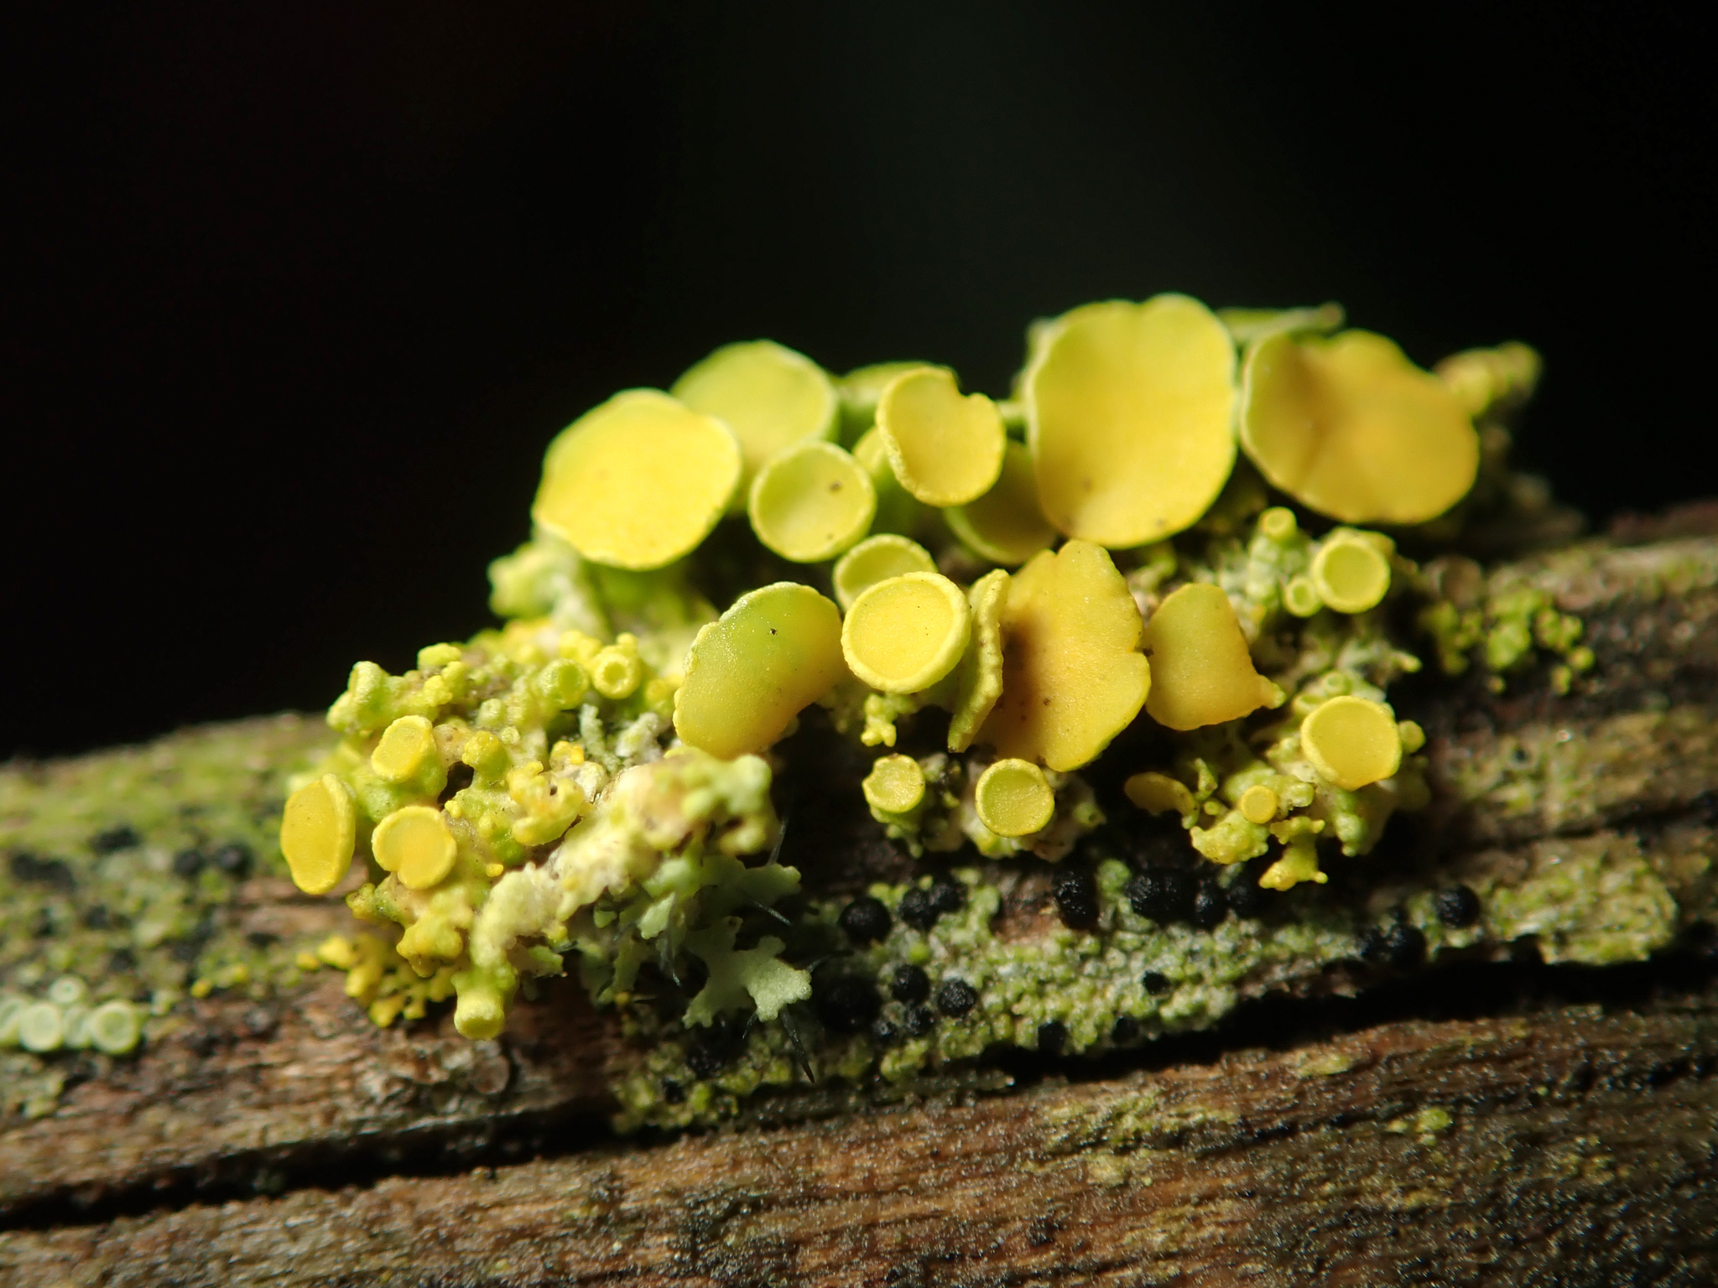
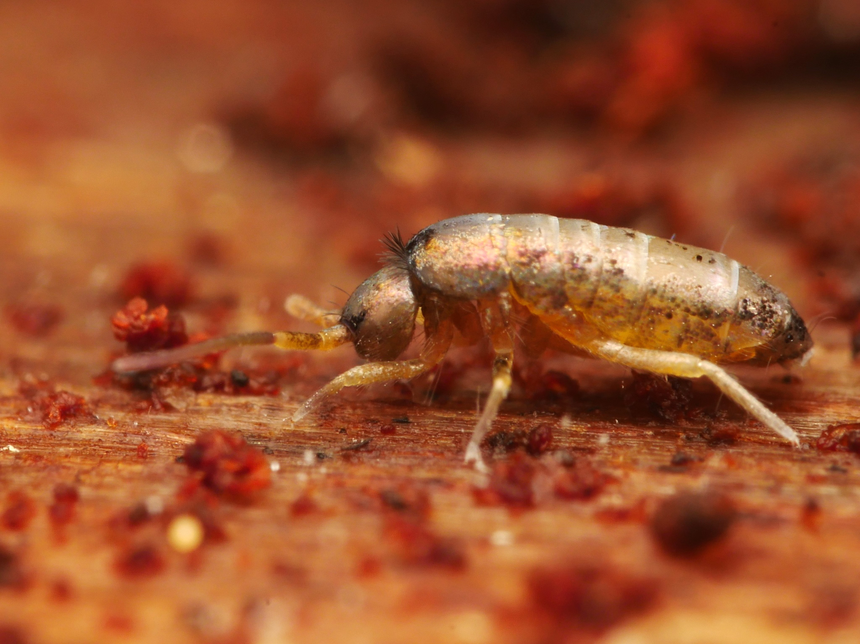
Featured soil-related datasets
Global soil organisms
Collembola of the relict forests of the Russian Far East
BIOWIDE eDNA Fungi dataset
Long-term dynamics of Collembola communities in a spruce forest and a meadow (1991-1997)
Notes:
Notes

Slide 6
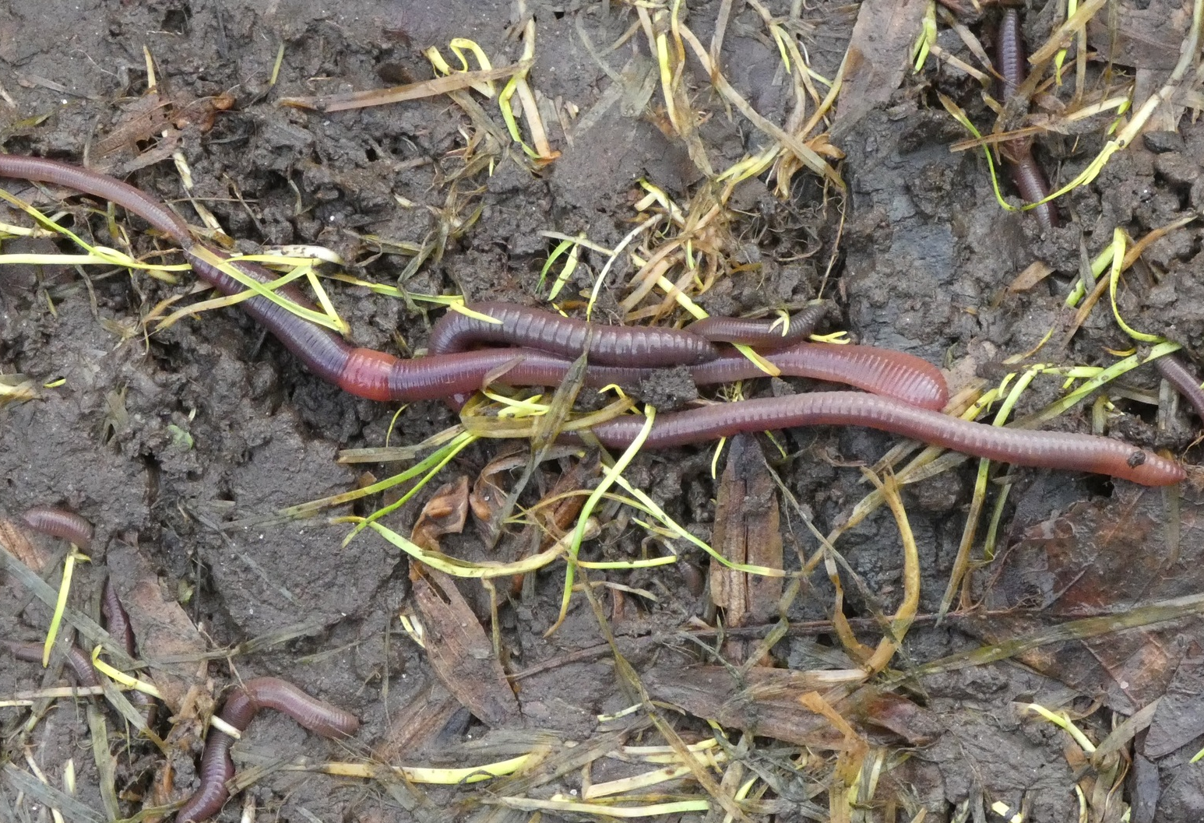
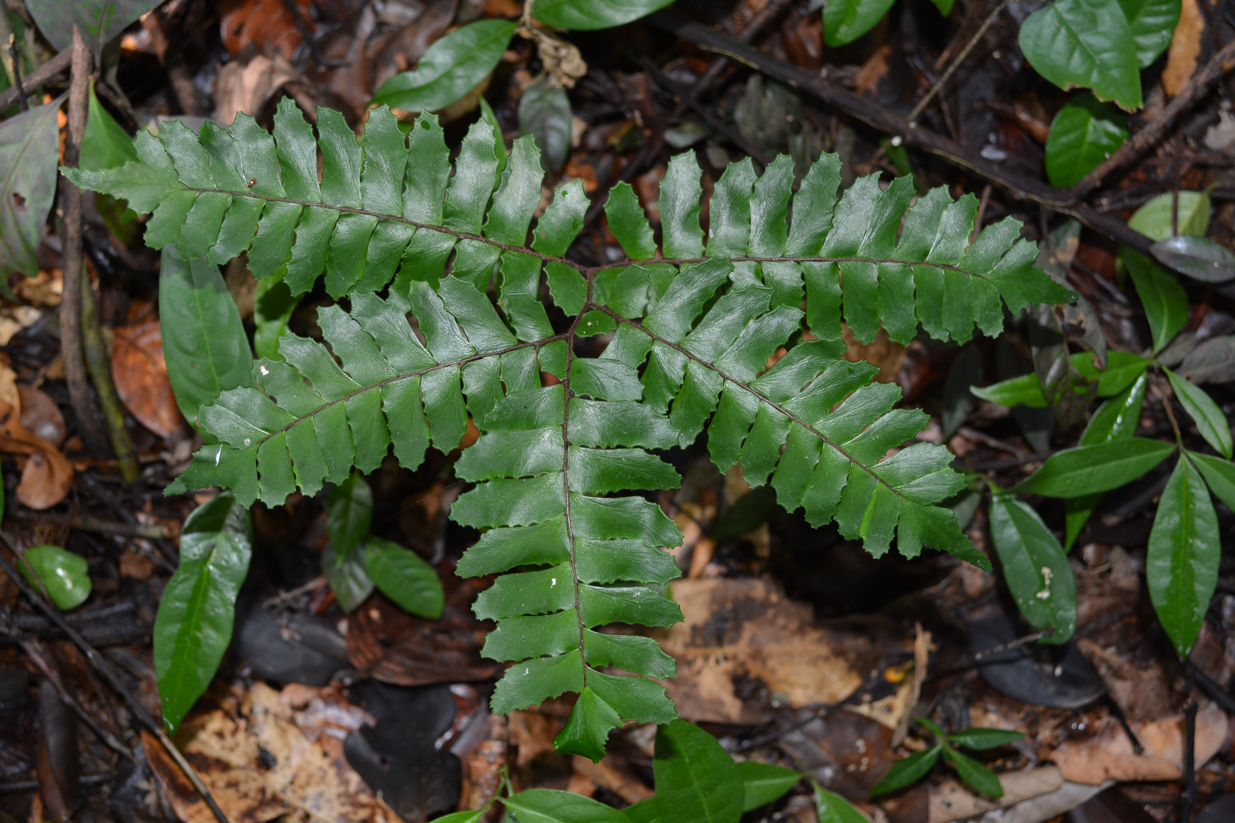
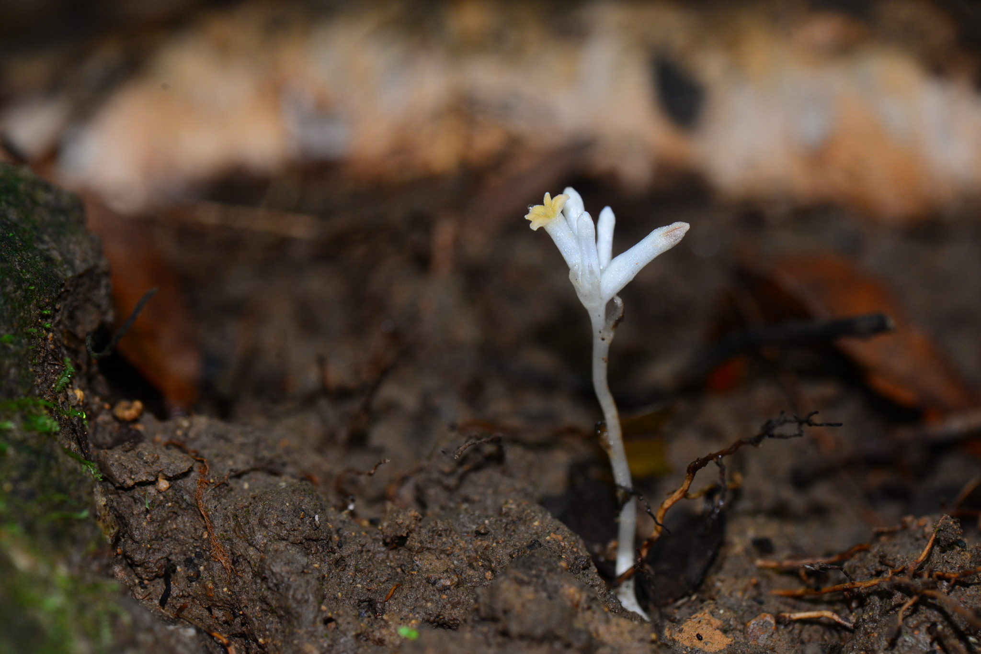
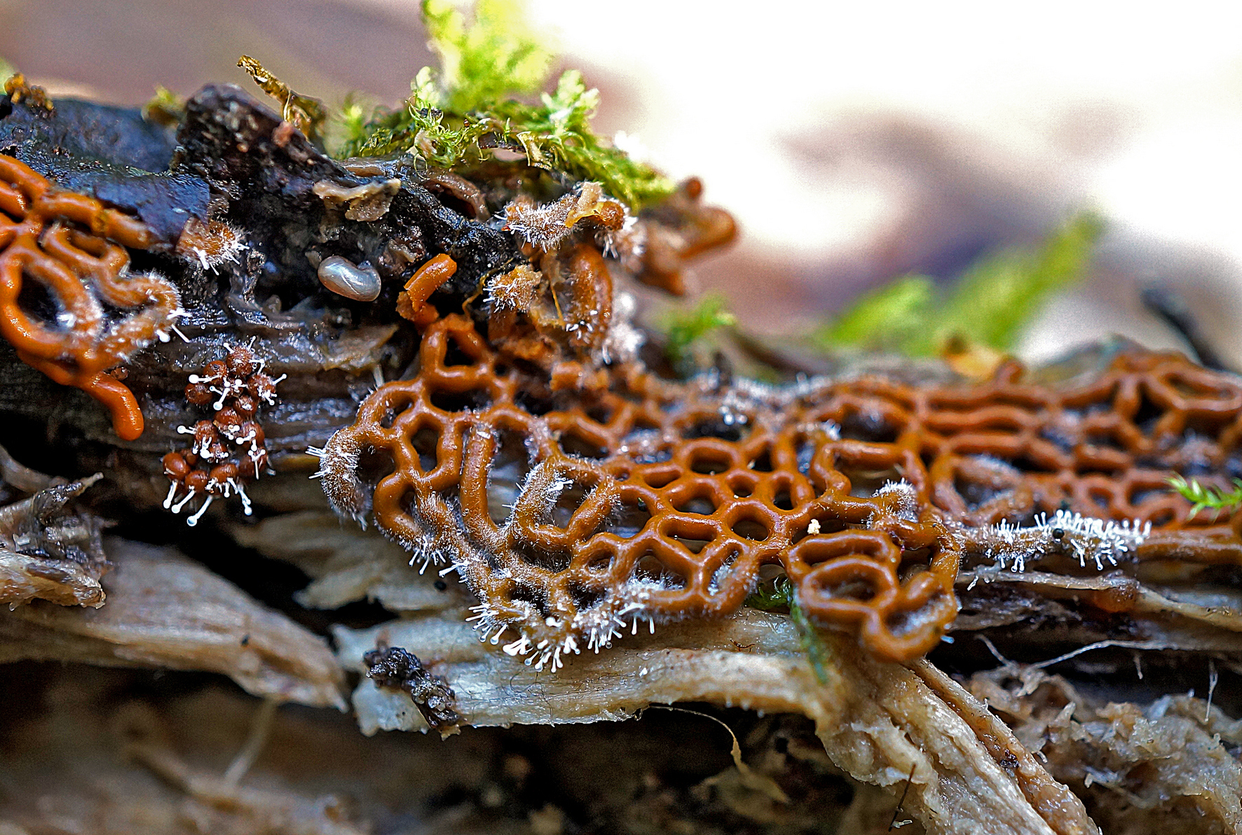
Featured data uses in soil-related research
Using soil hydromechanics to predict global earthworm distribution
Mapping environmental properties in data‐poor areas using species occurrences
Exploring the global distribution of mycoheterotrophic plants
Diversity of slime moulds–much more than meets the eye
Notes:
Notes

Slide 7
Soil
Learn more!

